Slide 1
A room and a classroom: how the coronavirus is spread through the air
This following graphics were downloaded from an article in the newspaper El Pais that can be found here:
https://english.elpais.com/society/2020-10-28/a-room-a-bar-and-a-class-how-the-coronavirus-is-spread-through-the-air.html

Slide 2
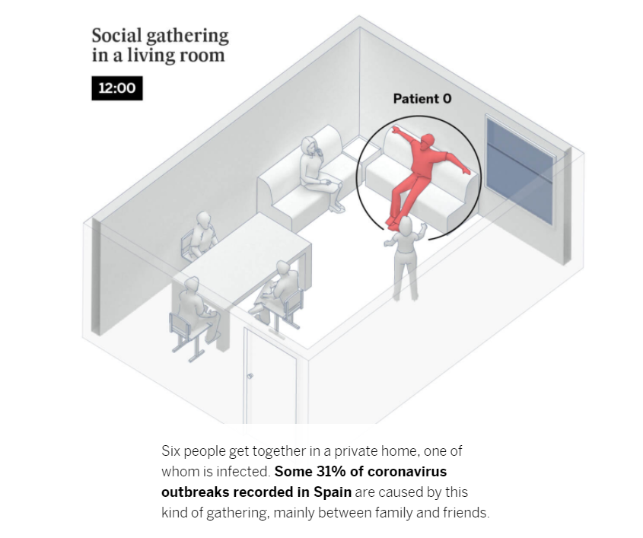

Slide 3
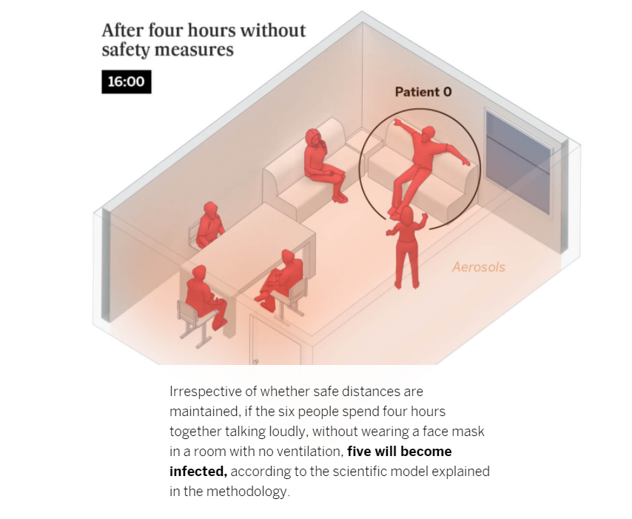

Slide 4
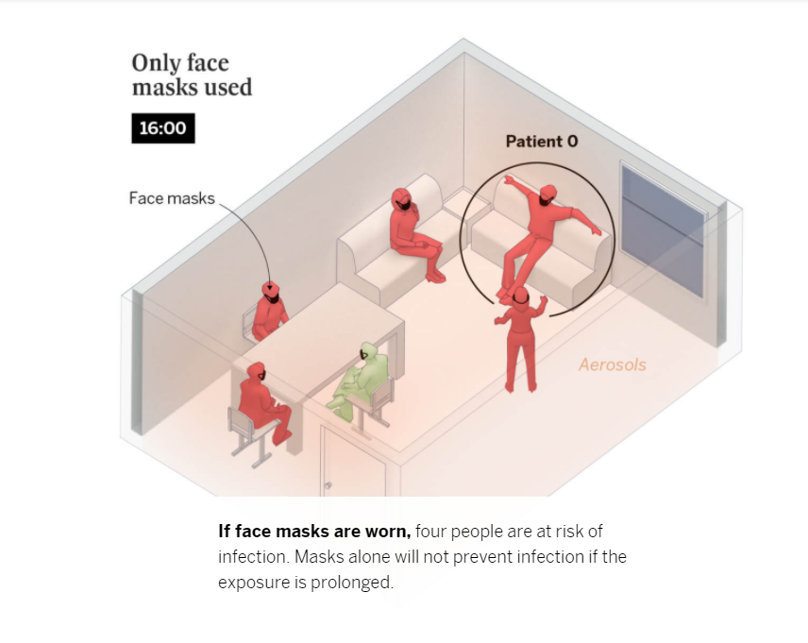

Slide 5
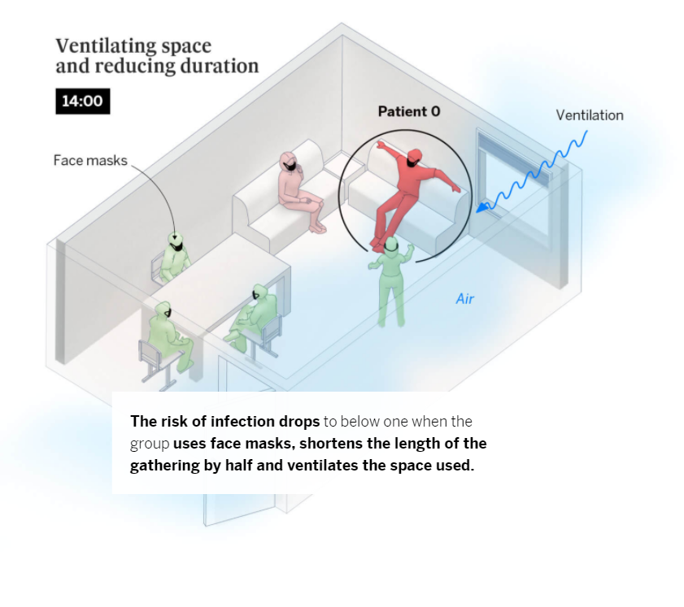

Slide 6
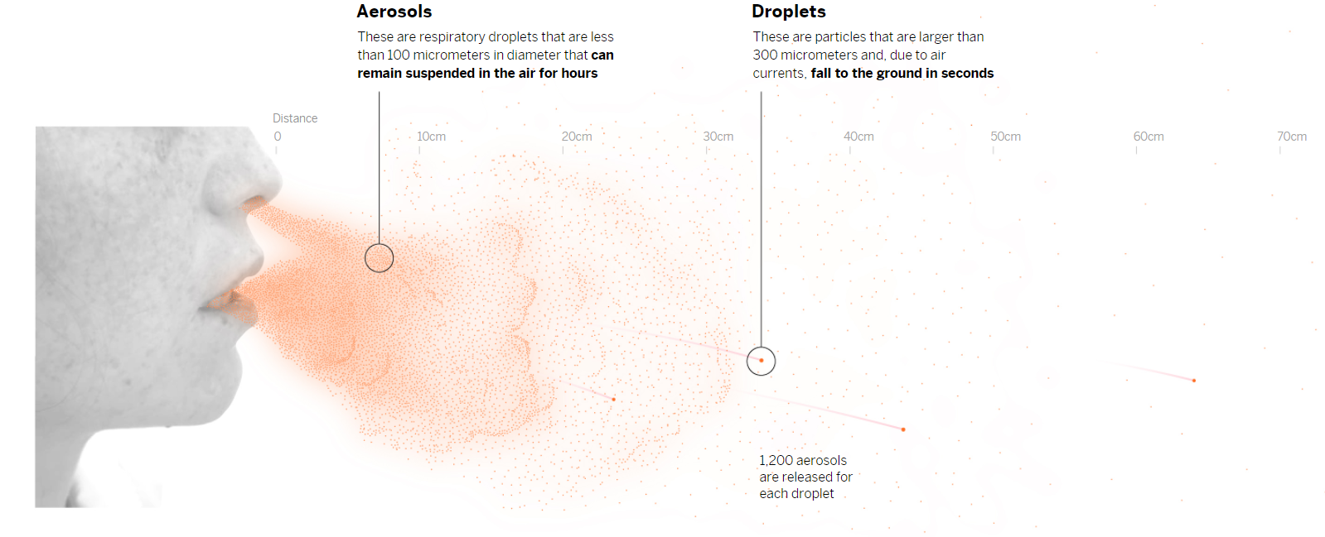

Slide 7

Video: Without ventilation, aerosols remain suspended in the air, becoming increasingly concentrated

Slide 8
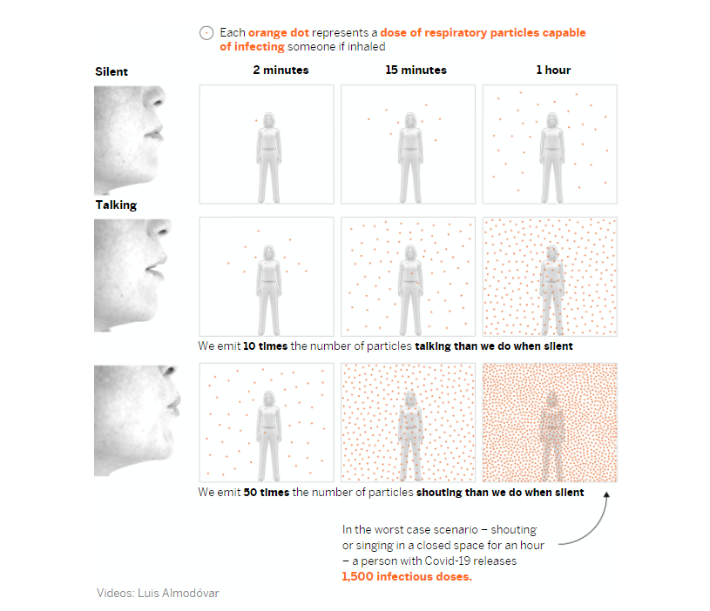

Slide 9
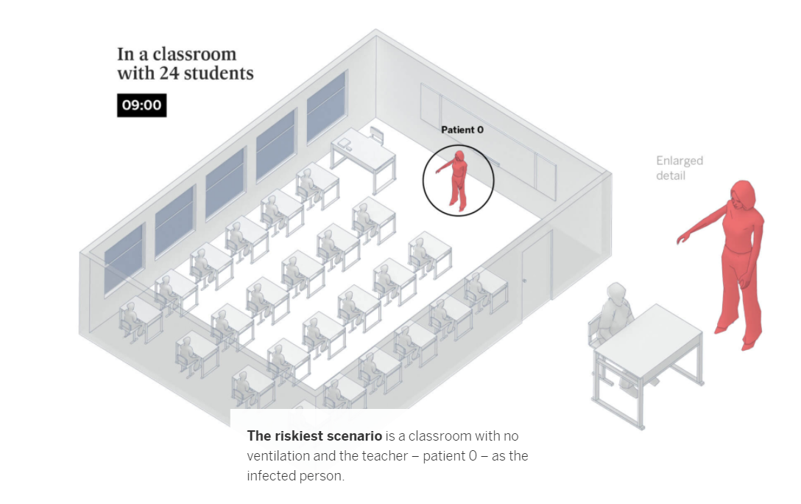

Slide 10
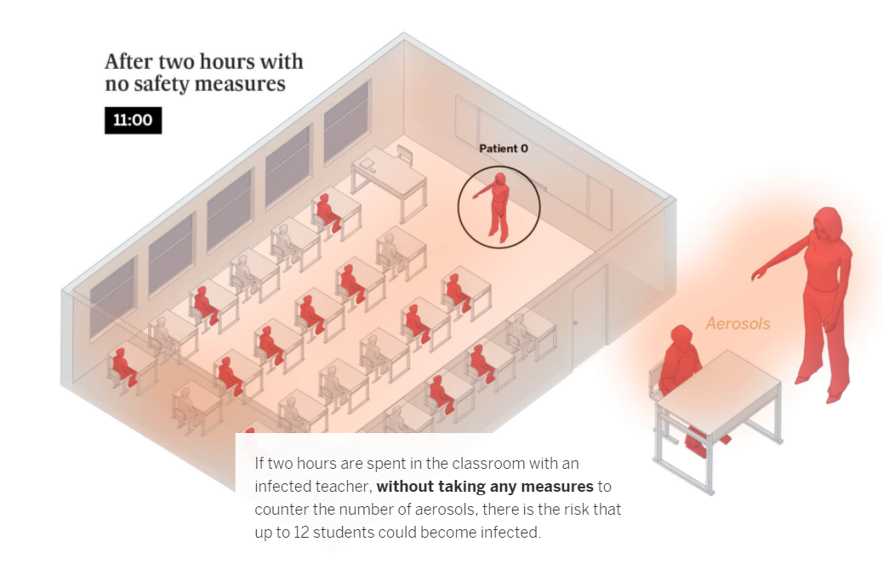

Slide 11
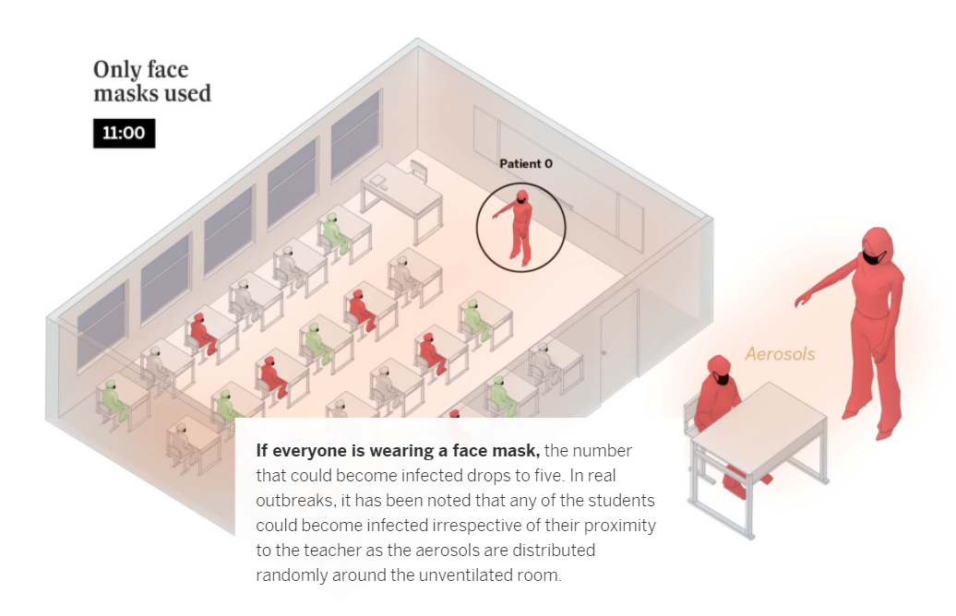

Slide 12
